Slide 1
Simple Banking Application
Name :S Vignesh
Enrollment Number :EBEON03251076632
Batch :2024-14789

Slide 2
Project Overview
The project simulates simple banking application
Operations:
- Check Balance
- Deposit
- Withdraw
- Exit

Slide 3
Objectives
Understand and implement:
- Input handling using Scanner
- Conditionals (if/else)
- Loops (do-while)
- Methods and classes
- Object-oriented concepts (inheritance)

Slide 4
Project Architecture
Class 1: Bank
- Handles core operations (deposit, withdraw, check balance)
Class 2: BankingApp
- User interface (console-based)
- Calls methods from Bank based on user input

Slide 5
Key Features
- Input validation for deposit and withdraw
- Menu-driven interaction
- Real-time balance updates
- Uses static variable for shared balance

Slide 6
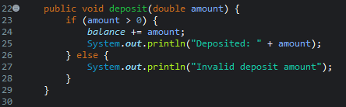
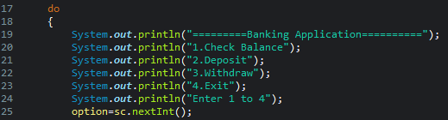
Code Snippets
Bank.java - deposit method:
BankingApp.java - menu loop:

Slide 7
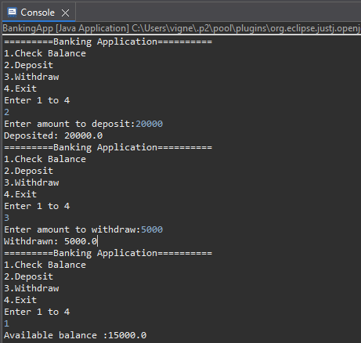
Output Demo

Slide 8
Learning Outcomes
Improved understanding of:
- Java syntax and control structures
- Object-oriented design
- Real-world application logic

Slide 9
Future Enhancements
- Add user authentication.
- Support for multiple users.
- Persistent data storage using files or databases.
- GUI using JavaFX or Swing.

Slide 10
Conclusion
- A simple project with powerful impact for Java learners.
- Demonstrates the power of object-oriented programming in real applications.

